Slide 1
Software Defined Networking (SDN) training
Module 3: Virtual network

Slide 2
Copyright and terms of use
Copyright and trademarks
This training package is proprietary and confidential and is intended only for uses described in the training materials. Content and software is provided to you under a Non-Disclosure Agreement and cannot be distributed. Copying or disclosing all or any portion of the content and/or software included in such packages is strictly prohibited.
The contents of this package are for informational and training purposes only and are provided "as is" without warranty of any kind, whether express or implied, including but not limited to the implied warranties of merchantability, fitness for a particular purpose, and non-infringement.
Conditions and terms of use
Training package content, including URLs and other Internet Web site references, is subject to change without notice. Because Microsoft must respond to changing market conditions, the content should not be interpreted to be a commitment on the part of Microsoft, and Microsoft cannot guarantee the accuracy of any information presented after the date of publication. Unless otherwise noted, the companies, organizations, products, domain names, e-mail addresses, logos, people, places, and events depicted herein are fictitious, and no association with any real company, organization, product, domain name, e-mail address, logo, person, place, or event is intended or should be inferred.

Slide 3
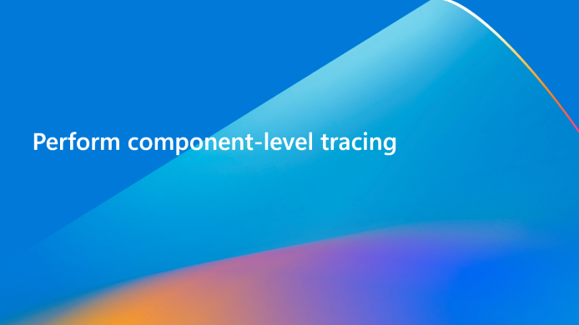


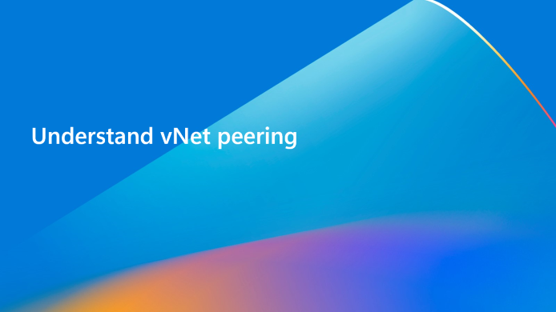
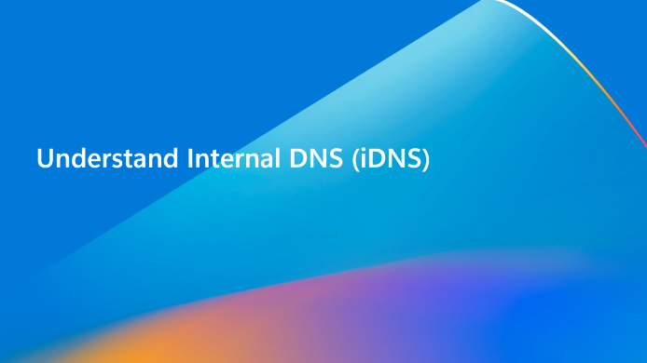
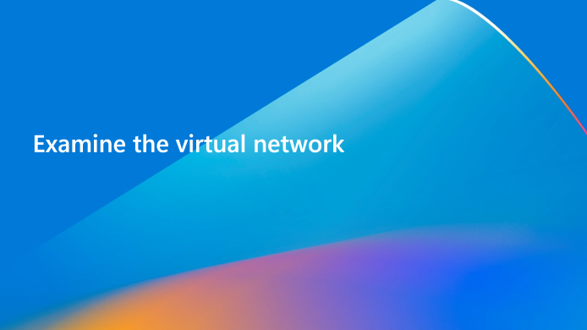
Learning objectives
By the end of this module, you will be able to:

Slide 4
Understand virtual network architecture

Slide 5
Virtual network service
The virtual network (vNet) service operates as a stateful service within Network Controller.
Controls the virtual networks and exposes capabilities to the management plane.
Runs parallel to virtual switch management service under the SDNVSM parent service.
Leverages the OVSDB protocol to push configuration to the MS_VTEP database.
Responsible for:
Tenant Customer Addresses (CA) and virtual network management.
Port CA to PA mappings management.
Route management for gateways, User Defined Routes (UDR), and ILB
Notes:
vSwitch is a stateful service module that is part of our Network Controller architecture. Virtual Network Manager within the vSwitch controls Virtual Networks and expose capabilities of our virtual networking solution to the management plane. It communicates and interacts with other Network Controller services to manage the dataplane routing.
vSwitch services performs some very important functionality, specifically:
Tenant CA & VNET management
Port CA PA Mappings management
Route management for gateways, UDR, ILB etc

Slide 6
Virtual switch management service
Virtual Switch Management performs all vSwitch operations and functionality.
Computes policies and pushes down to the Host Agent.
Runs parallel to the Vnet Service under the SDNVSM parent service.
Leverages WCF to push policies down to the host.
Performs the following:
QoS and SR-IoV settings for port and switch.
DNS and DHCP management for tenant ports.
Port security settings like MacSpoofing, ArpGuard, and DhcpGuard
Connectivity checks (CA PING).
Host PA address management.
Notes:
Virtual Switch Management is another service parallel to the VNET service. Both VNET and VSM reside in the parent container process by the name of SDNVSM.exe.
The VSM service performs all the vSwitch operations and functionality. It computes the policies and pushes them down to Hostagent which builds the corresponding VFP layers for carrying out all packet processing operations. VSM was originally intended to be with VNET service but due to limitations in the OVSDB protocol, a call was made to switch to WCF for pushing certain policies down to the host.
The following slide shows the policies processed by VNET and VSM service:
VSM:
QoS & IoV Settings for port & switch
DNS & DHCP management for tenant ports
Port Security settings like MacSpoofing, ArpGuard, DhcpGuard, StormLimit etc
Port Isolation Settings
Connectivity Checks (CA PING)
Host PA address management

Slide 7
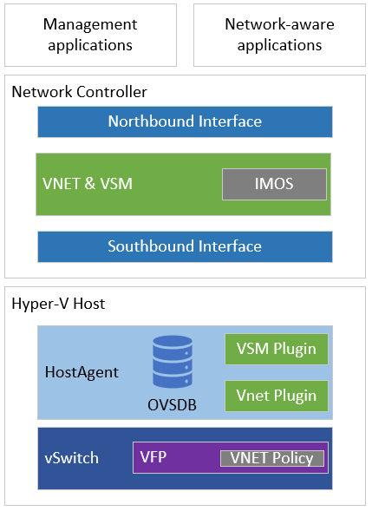
Architecture overview
Virtual network and virtual switch architecture is comprised of the following resources:
Northbound API
VNET service module
VSM service module
NC Host Agent
OVSDB
VSM Plugin
VNET Plugin
Virtual Filtering Platform (VFP)

Slide 8
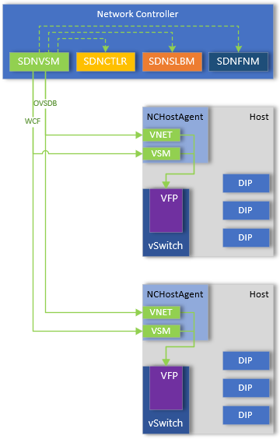
Policy configuration
SDN vSwitch service (SDNVSM) receives REST operations via Northbound API.
VNET module pushes policies southbound to NCHostAgent using OVSDB protocol.
VNET plug-in responsible for calculating difference in policies and programing VFP.
VSM module pushes policies to NCHostAgent using WCF.
VSM plug-in builds corresponding VFP layers for packet processing operations.
Notes:
VNET and VSM modules push goal state down to NCHostAgent using combination of WCF and OVSDB protocols. The plugins within the NCHostAgent service are responsible for calculating the policies and programming the appropriate layers within VFP to allow packet processing.

Slide 9
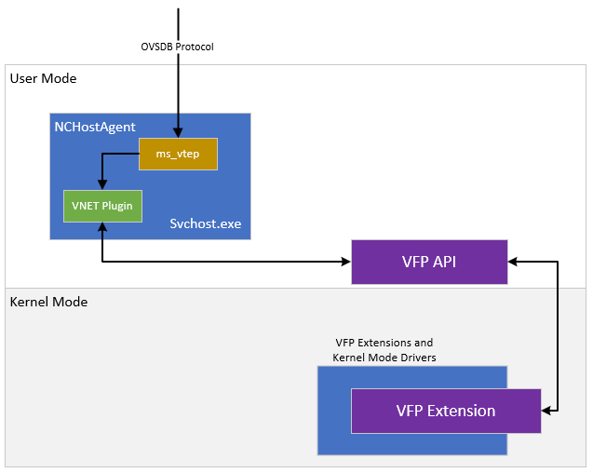
NCHost Agent
VSM service pushes policies into the ms_vtep database using OVSDB protocol.
VNET plug-in within NCHostAgent detects the changes and calculates policies.
VNET plug-in programs the policies via the VFP API.
Rules are then applied on the port for the NIC.
Notes:
The VNET Service Module, as part of the SDNVSM process, communicates via southbound API to NCHostAgent. Policy will be pushed into the ms_vtep database which will be picked up by the VNET plugin.
The VNET plugin will calculate policy and push the update policy configuration to the VFP API which will program the appropriate VFP rules within the VFP port(s).

Slide 10
Virtual network configuration
Configures the virtual network service of Network Controller.
This configuration is global for all virtual networks managed by Network Controller.
Represented within the network controller NB API as /networking/<apiVersion>/virtualNetworkManager/configuration

Slide 11
Virtual network manager resource
Property | Description
distributedRouterState | Indicates the state of the built-in distributed router of the virtual network. Values can be Enable or Disable. The default value is Enable.
networkVirtualizationProtocol | Indicates the encapsulation format String values which can be Network Virtualization using Generic Routing Encapsulation (NVGRE) ([RFC7637]) or Virtual Extensible LAN (VXLAN)([RFC7348]). The default value is VXLAN..
virtualSubnetIdRange | A structure of type VirtualSubnetIdRange, has the following two properties StartId and EndId. It allows configuration of the server to use a desired range of identifiers for virtual subnets. This property is supported with URI version v2 or later.
StartId | Indicates the minimum identifier that the server MUST use for virtual subnets. This value cannot be less than 4096. This property is supported with URI version v2 or later.
EndIp | Indicates the maximum identifier that the server MUST use for virtual subnets. This value cannot be greater than 16777215. This property is supported with URI version v2 or later.

Slide 12

Lab
Examine the vSwitch service.
Examine the NCHostAgent agent.

Slide 13
Knowledge check – virtual network architecture
What is the vNet Service Module responsible for?​
What protocol does the vSwitchService use to communicate with NCHostAgent?​
What plug-in with NCHostAgent is responsible for programming VFP policies related to customer addresses?
Notes:
See answers at end of the deck.

Slide 14
Examine the virtual network

Slide 15
What is a virtual network?
Tenant Virtual Networks (vNets) are the core building block for private network.
Enables secure communication of resources within the virtual network.
Can peer virtual networks together, enabling communication of resources between virtual networks.
Can communicate to on-premises network through S2S IPSec or S2S GRE tunnels, or by L3 gateway.
Represented within NC NB API as /networking/<apiVersion>/virtualNetworks/{resourceId}
Essentially a VXLAN or NVGRE overlay network.
Notes:
Virtual Network (vNet) is the fundamental building block for your private network in Azure and Azure Stack. vNet enables many types of resources, such as VMs, to securely communicate with each other, the internet, and on-premises networks. vNet is like a traditional network that you'd operate in your own data center but brings with it additional benefits of infrastructure such as scale, availability, and isolation.

Slide 16
Virtual network best practices
Ensure non-overlapping address spaces.
Subnets should not encompass the entire address space of the virtual network.
Recommend to leverage large virtual networks, rather than small virtual networks due to management overhead.
Subnets can be secured by assigning ACLs directly to the subnet.

Slide 17
Virtual network resource
Property | Description
addressSpace | Indicates the address space of the virtual network.
addressSpace.addressPrefixes | Indicates an array of the valid list of address prefixes that can make up the virtual network.
dhcpOptions | Indicates the DHCP options used by servers in the virtual network.
dhcpOptions.dnsServers | Indicates an array of DNS servers that are being used by the virtual network.
encryptionCredential | Reference to a credential resource of type X509 certificate
logicalNetwork | Indicates a reference to the networks resource that is the underlay network which the virtual network runs on.
subnets | Indicates an array of the subnets that are on the virtual network.
UnbilledAddressRanges | Comma separated values of IP ranges for which egress traffic is not billed (not tallied towards billing).
virtualNetworkPeerings | Indicates virtual networks that are peered to enable network traffic to flow between the virtual networks without the use of a gateway.

Slide 18
Subnet resource
Property | Description
accessControlList | Reference to an accessControlList resource that defines the ACLs for the subnet.
addressPrefix | Indicates the address prefix that defines the subnet.
BilledEgressBytes | Number of billed bytes sent by VMs with network interfaces with IP configurations from this virtual subnet.
dualStackSubnet | Reference to another virtual network subnet of the same virtual network resources.
encryptionEnabled | Indicates if encryption is enabled
ipConfigurations | Array of references of networkInterface resources that are connected to the subnet.
routeTable | A routeTable resource that defines the tenant routes to be applied to the subnet.
serviceInsertion | A serviceInsertions resource that defines the service insertion for the subnet.
UnbilledEgressBytes | Number of unbilled bytes sent by VMs with network interfaces with IP configurations from this virtual subnet.
VirtualSubnetId | String representation of the unique virtual subnet identified allocated by the network controller for this subnet.

Slide 19
What is a network interface?
Specifies the configuration of a vNIC on Hyper-V host or virtual server NIC.
Contains configuration details related to ipConfigurations, dnsSettings, macAddress, securityTags, and numerous other configurable properties.
There can be multiple network interfaces associated with a VM, as well as multiple ipConfigurations per network interfaces.
NIC will inherit any ACLs applied to the subnet the NIC is deployed within.
ACLs can be configured directly on the NIC in addition to subnet ACLs.
Public IP address can be added to the NIC, allowing NAT capabilities for external routing.
Can be associated to the load balancer backend address pool to enable load balancing.

Slide 20
Concepts
Address Space
When creating virtual network, you must specify an address space.
VMs deployed against the virtual network must fall within this range.
Subnet
Enables you to segment a virtual network into one or more subnets.
Resources can be deployed within the specific subnet.
Subnets can be secured with Access Control Lists (ACLs).
Network Interface
Contains the configuration details that maps to the VM network adapter.
Contains one or more ipConfiguration resources.
Define if primary interface, which is important if multiple interfaces attached to VM.
IP Configuration
Represent configuration information for IP addresses, such as allocation method, IP address, load balancing, and access control.

Slide 21
Network interface resource
Property | Description
counters | Array of ResourceCounter structures.
dnsSettings | Indicates the DNS settings of the network interface.
dnsSettings.dnsServers | Indicates an array of IP Addresses that this network interface resource will use for the DNS servers.
internalDnsNameLabel | Determines the name that will be registered in the internal Domain Name Service (iDNS) when the iDnsServer resource is configured.
ipConfigurations | Indicates an array of IP configurations that are contained in the network interface.
isHostVirtualNetworkInterface | Indicates this is a host virtual network interface card (host vNIC) versus virtual server NIC (VMNIC).
isMultitenantStack | Allows the NIC to be part of multiple virtual networks.

Slide 22
Network interface resource (continued)
Property | Description
isPrimary | Indicates primary interface.
portSettings | Array of port settings.
privateMacAddress | Indicates the private MAC address of the network interface.
privateMacAllocationMethod | Indicates the allocation scheme of the MAC for the network interface.
securityTags | An array of securityTags resources associated with the network interface.
server | Indicates a reference to the servers resource for the server that is currently hosting the VM to which this network interface belongs.
serviceInsertionElements | Indicates an array of serviceInsertions resources that this networkInterfaces resource is part of.

Slide 23
IP configuration resource
Property | Description
accessControlList | Indicates a reference to an accessControlLists resource that defines the ACLs in and out of the IP configuration.
isPrimary | Indicates the primary IP address when a network interface has more than one IP configuration.
loadBalancerBackendAddressPool | Reference to backendAddressPools child resource of the loadBalancers resource.
loadBalancerInboundNatRules | Reference to inboundNatRules child resource of the loadBalancers resource.
privateIPAddress | Indicates the private IP address of the IP configuration.
privateIPAllocationMethod | IP allocation method. Possible values are: Static, Dynamic, and Unmanged.
publicIPAddress | Indicates the public IP address of the IP configuration.
serviceInsertion | Indicates a reference to a serviceInsertions resource that defines the service insertion in and out of the IP configuration.
subnet | Indicates a reference to the subnets resource that the IP configuration is connected to.

Slide 24
Lab
Create a virtual network and subnets.
Create a VM.
Examine the Vswitch service and NCHostAgent.
View virtual network, subnet, and network interfaces in Network Controller.
View the data plane configuration.

Slide 25
Knowledge check – Virtual networks
How should you design virtual networks within your environment?​
What settings does the NetworkInterface contain?​
What settings does the IPConfiguration contain?
Notes:
See answers at end of the deck.

Slide 26
Understand Internal DNS (iDNS)

Slide 27
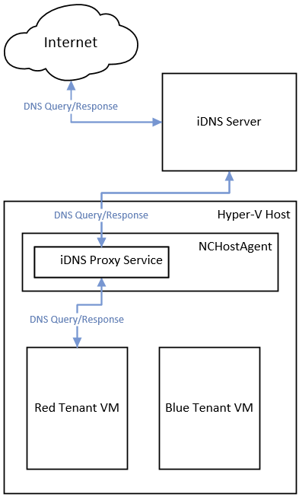
Overview of iDNS
Enables CSP or enterprise to provide DNS services to hosted workloads and applications.
Provides shared DNS services for tenant workloads.
Authoritative DNS service for name resolution and DNS registration within the tenant's name space.
Recursive DNS service for resolution of internet names from tenant VMs.
A cost-effective DNS solution - tenants don’t need to deploy their own DNS infrastructure.
Notes:
If you work for a Cloud Service Provider (CSP) or Enterprise that is planning to deploy Software Defined Networking (SDN) in Windows Server, you can provide DNS services to your hosted tenant workloads by using Internal DNS (iDNS), which is integrated with SDN.
Hosted virtual machines (VMs) and applications require DNS to communicate within their own networks and with external resources on the Internet. With iDNS, you can provide tenants with DNS name resolution services for their isolated, local name space and for Internet resources.
Because the iDNS service is not accessible from tenant Virtual Networks, other than through the iDNS proxy, the server is not vulnerable to malicious activities on tenant networks.
Key Features
Following are the key features for iDNS:
If desired, you can configure simultaneous hosting of fabric and tenant names
High availability with Active Directory integration, which is required.
In addition to these features, if you are concerned about keeping your AD integrated DNS servers open to the Internet, you can deploy iDNS servers behind another recursive resolver in the perimeter network.
Because iDNS is a centralized server for all DNS queries, a CSP or Enterprise can also implement tenant DNS firewalls, apply filters, detect malicious activities, and audit transactions at a central location

Slide 28
iDNS Network Controller configuration
NB API endpoint for iDNS server configuration is defined under networking/<API Version>/iDNSServer/configuration.
Contains connection references to the iDNS servers, zone, and credentials for authentication to iDNS servers.
Virtual Switch Manager is responsible for maintaining the DNS records on the iDNS server for the VMs.

Slide 29
iDNS server resource
Property | Description
Connections | Indicates a reference to collection of all the connections on the iDNS server of the deployment.
Zone | Indicates the DNS zone under which the tenant host DNS resource records as described in [RFC1034] section 3.6 are stored.

Slide 30
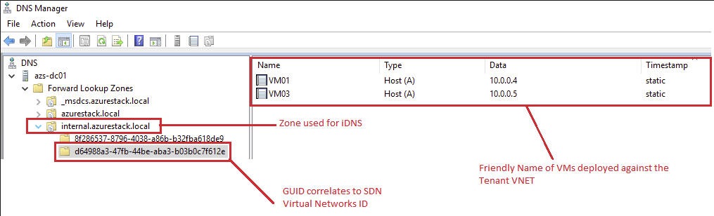
iDNS servers
Includes a set of DNS servers that host tenant-specific data.
Requires Active Directory integrated DNS to provide high availability.
iDNS servers are authoritative servers for their internal DNS zones.
All the host names for VMs on virtual networks are stored as DNS Resource Records under the same zone.
Tenant VM FQDN consist of the computer name and the DNS suffix string for the virtual network in GUID format.
Notes:
iDNS includes a set of DNS servers that host tenant-specific data, such as VM DNS Resource Records.
iDNS servers are the authoritative servers for their internal DNS zones, and also act as a resolver for public names when tenant VMs attempt to connect to external resources.
All of the host names for VMs on Virtual Networks are stored as DNS Resource Records under the same zone. For example, if you deploy iDNS for a zone named contoso.local, the DNS Resource Records for the VMs on that network are stored in the contoso.local zone.
Tenant VM Fully Qualified Domain Names (FQDNs) consist of the computer name and the DNS suffix string for the Virtual Network, in GUID format. For example, if you have a tenant VM named TENANT1 that is on the Virtual Network contoso,local, the VM's FQDN is TENANT1.vn-guid.contoso.local, where vn-guid is the DNS suffix string for the Virtual Network.

Slide 31
iDNS proxy
The iDNS Proxy Service runs under the NCHostAgent on each Hyper-V server in the SDN infrastructure.
It's designed to route DNS traffic using the VFPSwitch to and from the tenant virtual networks and the iDNS servers.
The iDNS Proxy Service requires registry keys containing the configuration to be stored on each Hyper-V host under the following registry keys:
HKEY_LOCAL_MACHINE\SYSTEM\CurrentControlSet\Services cHostAgent\Parameters\Plugins\Vnet\InfraServices\DnsProxyService
HKEY_LOCAL_MACHINE\SYSTEM\CurrentControlSet\Services\DNSProxy\Parameters
Notes:
The iDNS Proxy Service runs under the NCHostAgent on each Hyper-V server in the SDN infrastructure. It's designed to route DNS traffic (using the VFPSwitch) to and from the tenant virtual networks and the iDNS server in Azure Stack. In Windows Server 2016 environments, there is a stand-alone DnsProxy service that handles this, however with Windows Server 2019, this has been consolidated to run within NCHostAgent.

Slide 32
Tenant VM configuration
Tenant VM NIC must use DHCP as it will receive the DNS Server via the DHCP OFFER as part of the DHCP option field.
DNS Client Server Address should reflect what has been configured on the underlying host within the registry.
DNS Suffix should reflect the {VNET-NAME}.ZoneFQDN that has been configured within iDnsServer/Configuration of Network Controller.
If a server is domain-joined, it will automatically append the domain FQDN when doing lookup using NetBIOS name. If non-domain joined, will use the DNS suffix.
Notes:
DNS Server Address
When you examine the network settings for a tenant VM, you should see that a DNS Server Address is automatically defined if you deploy the VM against a Virtual Network that is using the default (azure-provided) DNS servers. The tenant VM will send its DNS traffic to the IP Address defined for name resolution.
DNS Suffix
As part of the name resolution process, the DNS Client will append the DNS Suffix to the NetBIOS name that you provide during a Test-NetConnection or ping.
If your machine is domain joined, it will automatically append the domain FQDN. If the machine is non-domain joined and you do query for NetBIOS name of a server, it will append the DNS Suffix in the list.

Slide 33
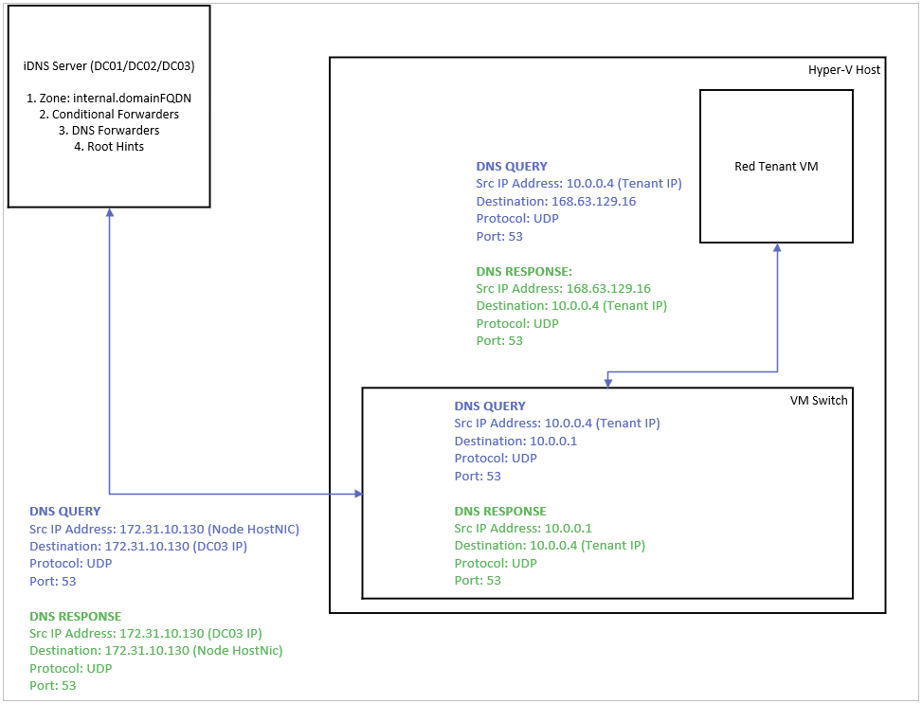
iDNS behavior and packet flow
Notes:
Examine local DNS cache.
If no cache, then send DNS Query to its primary DNS server, in this case 168.63.129.16.
VMSwitch/VFP redirects the DNS Query to the default gateway for that virtual network.
DNSProxy which is listening on the default gateway will then forward the DNS Query to the iDNS server management addresses defined in its configuration, which will be DC01,DC02 or DC03 in Azure Stack.
DNS query leaves the Hyper-V host as the HostNic IP address of the host and is routed to DC server(s) that are hosting the internal.domainFQDN zone.
At this point, DNS servers will do the following:
If authoritative, such as tenant VM attempting to resolve a name within the VNet such as another VM, it will respond with the appropriate records.
If matches the conditional forwarders, such as externalFQDN, it will forward to those DNS servers
If does not match its authoritative zones or conditional forwarders, then forward to the DNS Forwarders in the cloud operator's datacenter or whatever was defined.
If call to DNS Forwarder fails, then attempt to resolve name using Root Hints.
Once the lookup has completed, the response is returned to the tenant VM that initiated the lookup.

Slide 34
Lab
Deploy iDNS.
Examine tenant DNS settings.

Slide 35
Knowledge check – iDNS
What is the purpose of iDNS?
Notes:
See answers at end of the deck.

Slide 36
Understand vNet peering

Slide 37
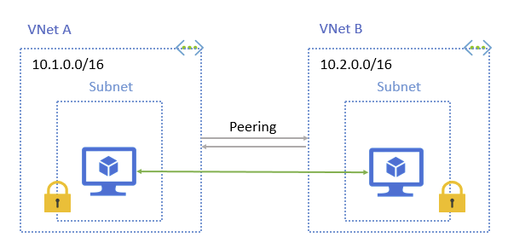
Overview of vNet peering
Allows you to connect two virtual networks seamlessly.
Traffic between VMs of peered virtual networks are routed through the HNA PA network.
Does not require public internet or gateways to route traffic between virtual networks.
Low latency, high bandwidth connection between resources.
No downtime between resources when creating the peering.

Slide 38
Constraints
Peered virtual networks must not have overlapping address spaces.
Must be managed by the same Network Controller cluster.
Once peering is established, you cannot add or delete address ranges within the virtual network address space without first removing the peering. Subnets can be added and removed.
Peering can only be set between two virtual networks.
There is no derived transitive relationship between the peered virtual networks.
Peering is available over version 3 and later versions of the NC REST API.
Notes:
Virtual network peering has a few requirements and constraints:
Peered virtual networks must:
Have non-overlapping IP address spaces
Be managed by the same Network Controller
Once you peer a virtual network with another virtual network, you cannot add or delete address ranges in the address space.
Since virtual network peering is between two virtual networks, there is no derived transitive relationship across peerings. For example, if you peer virtualNetworkA with virtualNetworkB and virtualNetworkB with virtualNetworkC, then virtualNetworkA does not get peered with virtualNetworkC.

Slide 39
Connectivity
Network latency between VMs is the same as latency within a single virtual network.
Network throughput is based on bandwidth allowed for the VM.
Traffic between the VMs is routed directly through the backbone infrastructure.
Access Control Lists (ACL) can be applied to block access for subnet ranges or VMs.
Notes:
After you peer virtual networks, resources in either virtual network can directly connect with resources in the peered virtual network.
Network latency between virtual machines in peered virtual networks is the same as the latency within a single virtual network.
Network throughput is based on the bandwidth allowed for the virtual machine. There isn't any additional restriction on bandwidth within the peering.
Traffic between virtual machines in peered virtual networks is routed directly through the backbone infrastructure, not through a gateway or over the public Internet.
Virtual machines in a virtual network can access the internal load-balancer in the peered virtual network.
You can apply access control lists (ACLs) in either virtual network to block access to other virtual networks or subnets if desired. If you open full connectivity between peered virtual networks (which is the default option), you can apply ACLs to specific subnets or virtual machines to block or deny specific access. To learn more about ACLs, see Use Access Control Lists (ACLs) to Manage Datacenter Network Traffic Flow.

Slide 40
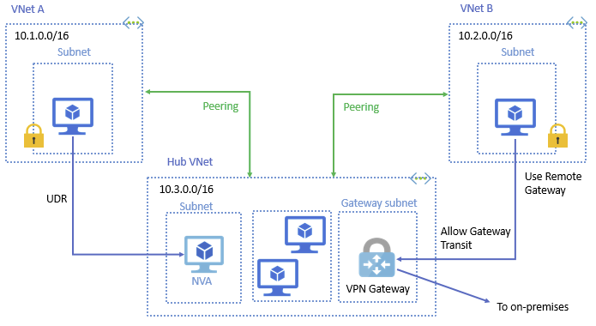
Service chaining
User-defined routes allow you to direct traffic on the subnet to next hop address.
Enables ability to deploy hub and spoke networks, which is common Azure design pattern.
Spoke virtual networks are used to isolate workloads in their own virtual networks, managed independently of other spokes.
Hub virtual network is the central point of connectivity between the spokes or on-premises network.
Notes:
You can configure user-defined routes that point to virtual machines in peered virtual networks as the next hop IP address, to enable service chaining. Service chaining enables you to direct traffic from one virtual network to a virtual appliance, in a peered virtual network, through user-defined routes.
You can deploy hub-and-spoke networks, where the hub virtual network can host infrastructure components such as a network virtual appliance. All the spoke virtual networks peer with the hub virtual network. Traffic can flow through network virtual appliances in the hub virtual network.
Virtual network peering enables the next hop in a user-defined route to be the IP address of a virtual machine in the peered virtual network.

Slide 41
Gateways and on-premises connectivity
Each virtual gateway can have its own gateway to connect to on-premises network.
When you peer virtual networks, you can configure the gateway in peered virtual network as transit by setting allowGatewayTransit:$true.
useRemoteGateway can only be set if the remote peered virtual network has allowGatewayTransit:$true configured.
A virtual network can only have one gateway, which can be either local or remote (in the peered virtual network).
Notes:
Each virtual network, regardless of whether peered with another virtual network, can still have its own gateway to connect to an on-premises network. When you peer virtual networks, you can also configure the gateway in the peered virtual network as a transit point to an on-premises network. In this case, the virtual network that uses a remote gateway cannot have its own gateway. A virtual network can have only one gateway that can be either a local or remote gateway (in the peered virtual network). Constraints and limitations for the "Allow gateway transit" scenario:
The VNET peer where the flag "Allow gateway transit" is set must have the VNG built for the flag to be set.
The "Use remote gateway" flag can only be set if the "Allow gateway transit" is set on the remote peer. Trying to set it before setting the "Allow gateway transit" will fail with an explicit error.
Only one peer can have an VNG if these two flags are set.
None of the subnets part of this Peering can overlap, this includes the S2S tunnel remote subnets.
For the VNet peer that is using the remote VNG (built on the other VNet peer) only the subnets that exist when the VNet Peering is set up will have access to the subnets available over the S2S VPN built on the remote peer. The next subnets that will be created will only have access to the peer's subnets. This is consistent with Azure.

Slide 42
Virtual network peering resource
Property | Description
peeringState | Values are Initiated, Connected, Disconnected, or Disconnecting. Initiated - Peering is initiated if the remote virtual network doesn’t have a matching peering. Connected - Two virtual networks have peerings each referencing the other. Disconnected - When remote peering or virtual network is deleted.
remoteVirtualNetwork | Indicates a reference to a virtualNetworks resource that defines the other peer. The current virtual network and the specified virtual network are going to be peered.
allowVirtualNetworkAccess | True or False, default is TRUE. A knob that enables or disables traffic between the peered networks.
allowForwardedTraffic | True or False, default is FALSE. Whether traffic not originated from the peered virtual networks is accepted or dropped.
allowGatewayTransit | True or False, default is FALSE. Indicates whether the remote (peered) virtual networks can use gateways configured for this virtual network.
useRemoteGateways | If virtual networks should use gateways configured for the remote (peered) virtual networks.
remoteAddressSpace | This is the addressSpace property (section 3.1.5.18) of the peered virtual network.

Slide 43
Lab
Create vNet peering.
Collect network traces.

Slide 44
Knowledge check – vNet peering
Can you modify the virtual network address space if you have virtual network peering established?​
Can virtual gateways be shared with virtual network peering?
Notes:
See answers at end of the deck.

Slide 45
Understand virtual network routing

Slide 46
System Routes
Routes are automatically created for each subnet in a virtual network.
You cannot create or remove system routes; however you can override some system routes with custom routes.
System routes are automatically created, modified or removed when you add services and capabilities.
Notes:
Network Controller automatically creates system routes and assigns the routes to each subnet in a virtual network. You can't create system routes, nor can you remove system routes, but you can override some system routes with custom routes. Network Controller creates default system routes for each subnet, and adds more optional default routes to specific subnets, or every subnet, when you use specific capabilities.

Slide 47
Default Routes
Each route contains an address prefix and next hop type
When traffic leaving a subnet is sent to an IP address within the address prefix route, the route that contains the address is the route used.
Whenever a virtual network is created, the default system routes are automatically created
Notes:
Each route contains an address prefix and next hop type. When traffic leaving a subnet is sent to an IP address within the address prefix of a route, the route that contains the prefix is the route Azure Stack HCI uses. Whenever a virtual network is created, Network Controller automatically creates default system routes for the virtual network

Slide 48
Optional default routes
More routes are automatically added, but only if you enable the capabilities.
Source | Address prefixes | Next hop type | Subnet within virtual network that route is added to
Default | Unique to the virtual network. | Virtual Network Peering | All
Virtual Network Gateway | Prefixes advertised from remote peer via BGP or configured via static routes. | Virtual Network Gateway | All
Notes:
Network Controller adds more default system routes for different capabilities, but only if you enable the capabilities. Depending on the capability, Network Controller adds optional default routes to either specific subnets within the virtual network, or to all subnets within a virtual network. The other system routes and next hop types that Network Controller may add when you enable different capabilities are defined within this table.
Virtual network (VNet) peering: When you create a virtual network peering between two virtual networks, the system adds a route for each address range within the address space of each virtual network involved in the peering.
Virtual network gateway: One or more routes with Virtual network gateway listed as the next hop type are added when a virtual network gateway is added to a virtual network. The source is also virtual network gateway, because the gateway adds the routes to the subnet. If your on-premises network gateway exchanges border gateway protocol (BGP) routes with a virtual network gateway, the system adds a route for each route. These routes are propagated from the on-premises network gateway. We recommend summarizing on-premises routes to the largest address range possible, so you propagate the fewest number of routes to a virtual network gateway. There are limits to the number of routes you can propagate to a virtual network gateway.

Slide 49
User-defined routes
You can create custom or user-defined(static) routes to override default system routes.
You can create a route table and associate to one or many virtual network subnets.
Limit of one route table per virtual network subnet.
If conflicting route assignments, user-defined routes override default.
Notes:
You can create custom, or user-defined(static), routes in Network Controller to override the default system routes, or to add more routes to a subnet's route table. You create a route table, then associate the route table to zero or more virtual network subnets. Each subnet can have zero or one route table associated to it. When you create a route table and associate it to a subnet, the table's routes are combined with the subnet's default routes. If there are conflicting route assignments, user-defined routes override the default routes.

Slide 50
Route selection
Destination IP address using longest prefix match algorithm.
If multiple routes contain same address prefix, priority is used:
User-defined route
BGP route
System route
System routes for traffic related to virtual network or virtual network peering are preferred over BGP.
Notes:
When outbound traffic is sent from a subnet, Network Controller selects a route based on the destination IP address, using the longest prefix match algorithm. For example, a route table has two routes: One route specifies the 10.0.0.0/24 address prefix, while the other route specifies the 10.0.0.0/16 address prefix. Network Controller directs traffic destined for 10.0.0.5 to the next hop type specified in the route with the 10.0.0.0/24 address prefix. This process occurs because 10.0.0.0/24 is a longer prefix than 10.0.0.0/16, even though 10.0.0.5 falls within both address prefixes. Network Controller directs traffic destined for 10.0.1.5 to the next hop type specified in the route with the 10.0.0.0/16 address prefix. This process occurs because 10.0.1.5 isn't included in the 10.0.0.0/24 address prefix, making the route with the 10.0.0.0/16 address prefix the longest matching prefix.
If multiple routes contain the same address prefix, Network Controller selects the route type, based on the following priority:
- User-defined route
- BGP route
- System route
NOTE: System routes for traffic related to virtual network or virtual network peerings are preferred routes, even if BGP routes are more specific.

Slide 51
0.0.0.0/0 address prefix
When you add 0.0.0.0/0 address prefix, all traffic outbound is directed to the next hop, whether that is virtual network gateway or virtual appliance.
Accessing resources using the L3 NAT (Public IP Address) or Load Balancer Public VIP will no longer work outside of the SDN cluster.
Do not associate route tables to gateway subnet that includes 0.0.0.0/0, as this will break virtual gateway functionality.
Notes:
In some scenarios, you can route all traffic to a specific next hop by defining a 0.0.0.0/0 address prefix, and then specifying the Virtual Network Gateway or Virtual Appliance, such as a firewall NVA. All outbound traffic from within the Virtual Network will be sent to this next hop then. Be mindful that this may break some capabilities that you may have deployed.
Accessing resources within virtual network using L3 NAT (Public IP Address) or Load Balancer VIP endpoint will fail, as the traffic will be redirected to the next hop. In this example, the return traffic will not be Sourced NATed (SNAT) to include the public IP, and instead will be sent to the next hop using the privateIP address of the VM as source. The nextHop device will process and would send packet back to original caller.

Slide 52
Next hop type (all)
Type | Description | Resource
Virtual Network Gateway | Specify when you want traffic destined for specific address prefixes routed to a virtual network gateway. The virtual network gateway must be created with type VPN. | Gateway Connections.
Virtual Network | Specify when you want to override the default routing within a virtual network | Virtual Network and Subnets.
Internet | Specify when you want to explicitly route traffic destined to an address prefix to the Internet
Appliance | A virtual appliance is a virtual machine that typically runs a network application, such as a firewall. | User Defined Route.
None | Specify when you want to drop traffic to an address prefix, rather than forwarding the traffic to a destination. | Non-configurable system route.
Virtual Network Peering | Specify when you want to connect one or more Virtual Network address spaces together. | Virtual Network Peering.
Notes:
This table summarizes the route types that exist, and which corresponding resource they are associated with.

Slide 53
Lab
There’s no lab for the Virtual network routing topic.

Slide 54
Knowledge check – Virtual network routing
What are user defined routes commonly used for?​
Which routes take priority?
Notes:
See answers at end of the deck.

Slide 55
Perform component-level tracing

Slide 56
Trace logging
As Virtual Network Manager and Virtual Switch Manager is part of Network Controller, refer to the M1_Network_Controller module regarding trace logging.

Slide 57
Lab
There’s no lab for the component-level tracing topic.

Slide 58
Resources
Azure network security overview.
Use Network Virtual Appliances on a Virtual Network
virtualNetworks
networkInterfaces
iDnsServer
Internal DNS Service (iDNS) for SDN
Virtual Network Traffic Routing
Virtual network peering
virtualNetworkPeerings
DHCP Basics

Slide 59
Knowledge check answers (1/2)
Learning objective | Questions | Answers
1: Virtual network architecture | What is the vNet Service Module responsible for?​ What protocol does vSwitchService use to communicate with NCHostAgent?​ What plug-in with NCHostAgent is responsible for programming VFP policies related to customer addresses? | Tenant Customer Addresses (CA) and virtual network management; Port CA PA mappings management; Route management for gateways, User Defined Routes (UDR), ILB.​ OVSDB​. vNET.
2. Virtual networks | How should you design Virtual Networks within your environment?​ What settings does the NetworkInterface contain?​ What settings does the IPConfiguration contain? | 1. Larger virtual networks with smaller subnets, non-overlapping address range.​ Contains ipconfigurations, associated NSG or SecurityTags,and DNS settings​. Contains private IP address, associated public IP or Load Balancer resource, and user defined routes.

Slide 60
Knowledge check answers (2/2)
Learning objective | Questions | Answers
3. Internal DNS (iDNS) | What is the purpose of iDNS? | Enables you as a CSP or an enterprise to provide DNS services to hosted workloads and applications.
4. Virtual network peering | Can you modify the Virtual Network address space if you have Virtual Network Peering established?​ Can the Virtual Gateways be shared with Virtual Network peers? | No. You must first delete the Virtual Network Peering before you modify the address space.​ Yes.
5. Virtual network routing | What are user defined routes commonly used for?​ Which routes take priority? | Commonly used to direct traffic on a subnet to a network virtual appliance, such as a firewall, or VPN device.​ User defined routes, with the longest matching prefix taking priority.

Slide 61
Summary
In this module, you learned about:
Virtual network architecture
Virtual networks
Internal DNS (iDNS)
Virtual network peering
Virtual network routes
Component level tracing

